Slide 1

EMPLOYEE RETENTION

Slide 2

Project Name : H R Analytics – Employee Retention GROUP: 5 Project Members : Sandeep Vipul Bhagwat Deva Pallab Amol Ashwanth anil nair

Slide 3

AGENDA :
Introduction & Problem Statement
Business Objective
KPIs
Dashboard
Conclusion

Slide 4
Introduction: HR analytics involves the collection and analysis of HR-related data, including employee data, performance metrics, and other relevant data points. By using advanced analytical tools and techniques, HR analytics provides valuable insights into HR processes and trends, enabling organizations to make more informed decisions about their employees and improve overall performance.
Problem Statement:
Average attrition rate for all Departments
Average hourly rate of Male Research Scientist
Attrition rate Vs Monthly Income stats
Average working years for each Department
Job role Vs Work life balance
Attrition rate Vs Years Since last promotion

Slide 5
Business Objective:
The aim of this project is to analyze employee retention and attrition rates with the organization and provide insights to the HR team for developing effective retention strategies. Through data analysis and visualizations, we will identify factors that contribute to :
Employee turnover and attrition.
Evaluate the effectiveness of existing retention strategies.
To verify the satisfaction level of employee in the organization.
Provide recommendations to improve employee retention.

Slide 6
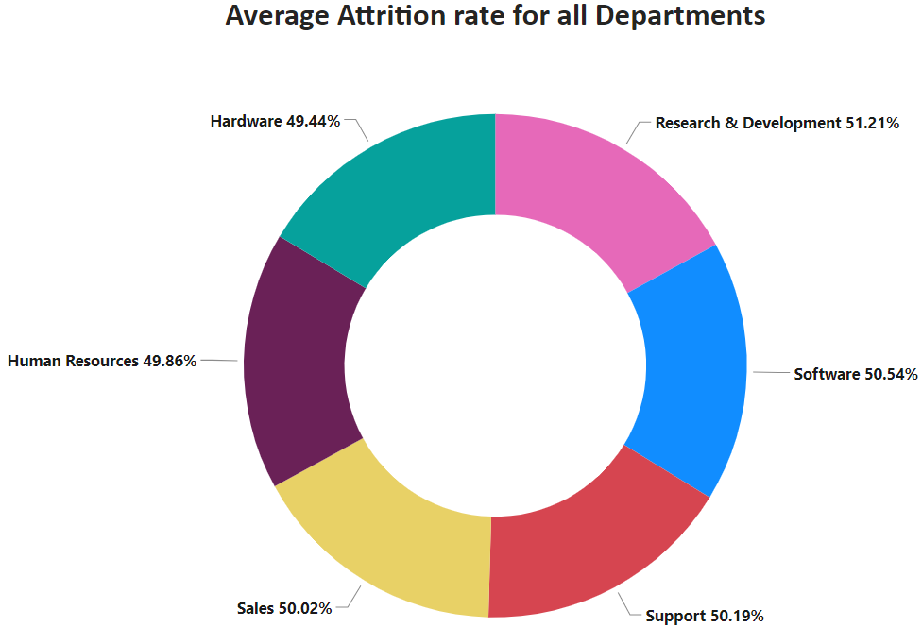
KPI 1 Average Attrition rate for all Departments
This KPI is to find out the
relationship between each
department and its attrition rate and here attrition rate is highest for Research & Development Department whereas lowest is for Hardware Department.

Slide 7
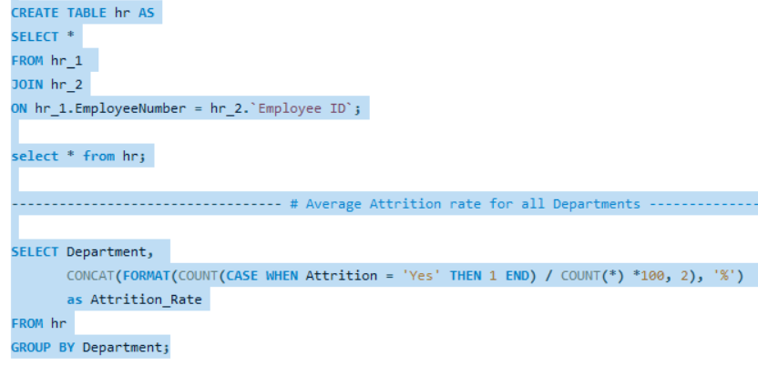
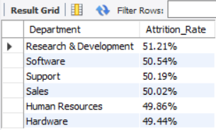
Insights from KPI 1:
We can clearly say that attrition rate of employees for every department is almost 50% which indicates that attrition rate of employees does not depends on department. So, irrespective of the department almost 50% of employees are leaving the company.
From this calculation and visualization we concluded that we must make strong strategies to minimize attrition rate and improve our company’s Employee retention so that we can balance the company’s growth and right talent.

Slide 8
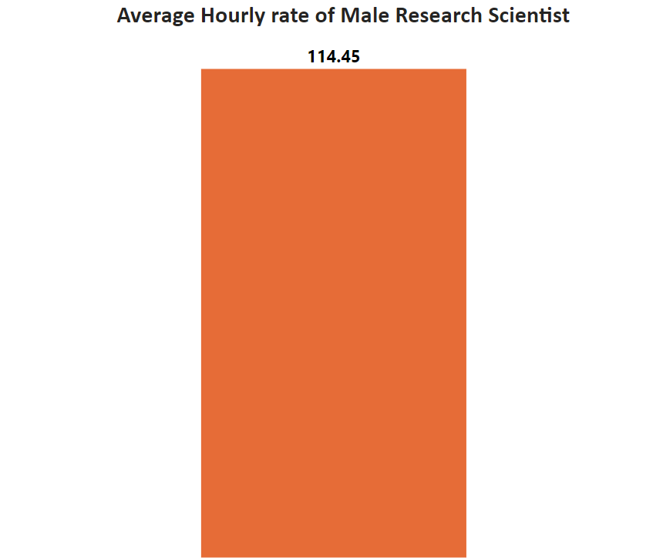
KPI 2 Average Hourly rate of Male Research Scientist
Insights from KPI 2 :
This KPI is to find out the average hourly rate of male research scientists which is 114.45.

Slide 9
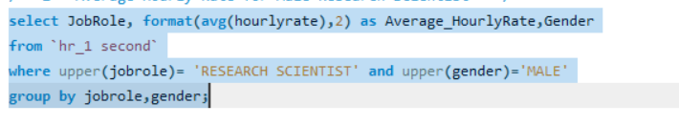

KPI 2 Average Hourly rate of Male Research Scientist
Insights from KPI 2 :
This KPI is to find out the average hourly rate of male research scientists which is 114.45.

Slide 10
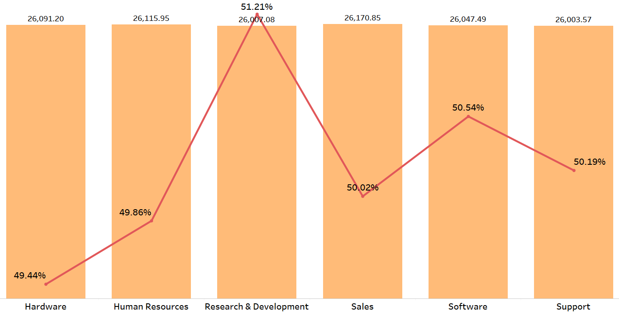
KPI 3 Attrition Rate Vs Monthly Income Stats
This KPI is to find out the relation the between monthly income and Attrition rate.

Slide 11
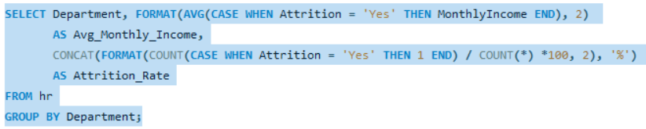
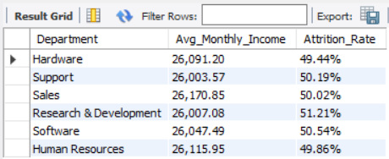
Insights from KPI 3:
Based on our analysis and visualization, it is evident that the Hardware Department has the lowest attrition rate of 49.44%, with an average monthly income of Rs. 26,091.20. On the other hand, the Research and Development Department has the highest attrition rate of 51.21%, with an average monthly income of Rs. 26,007.08

Slide 12
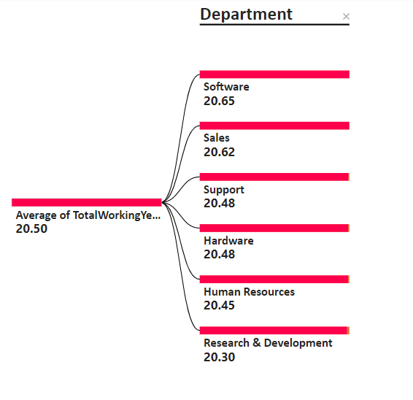
KPI 4 Average Working Years for each Department

Slide 13
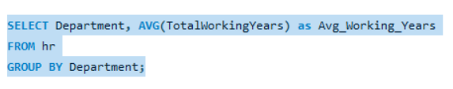
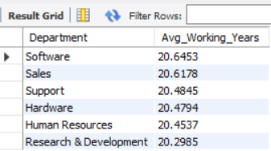
Insights from KPI 4:
From this we can see the average working years in software department is high as compared to the rest of the departments and lowest is for Research & Development Department.
From the analysis we can conclude that average working years is approximately 20 for all the departments.

Slide 14
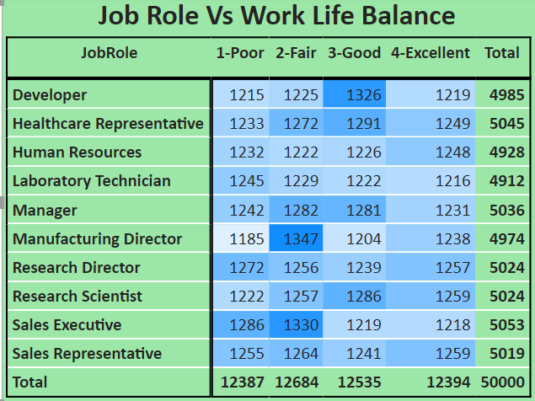
KPI 5 Job Role Vs Work Life Balance for Total Employees

Slide 15
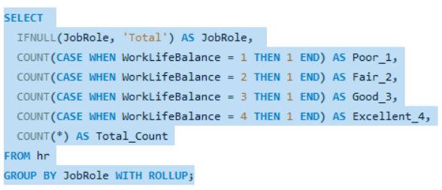
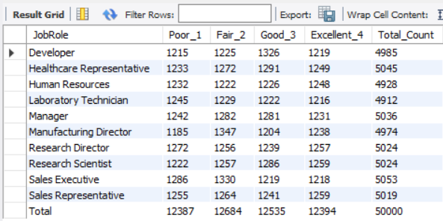
Insights from KPI 5:
From the analysis we can conclude that,
For Research directors and the laboratory technicians the work life balance is poor.
For the Sales representatives , managers , Manufacturing Directors and the Sales executives the work life balance is fair.
For Research Scientists , Healthcare representatives und Developers the work life balance is good.
For human resources the work life balance is excellent.

Slide 16
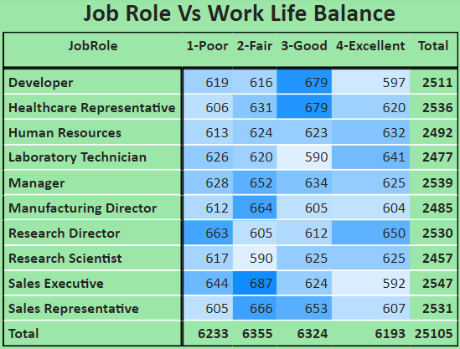
KPI 5 Job Role Vs Work Life Balance for attrition Employees

Slide 17
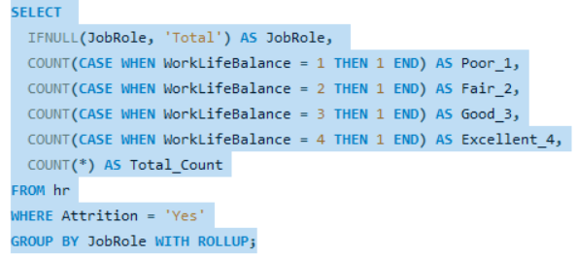
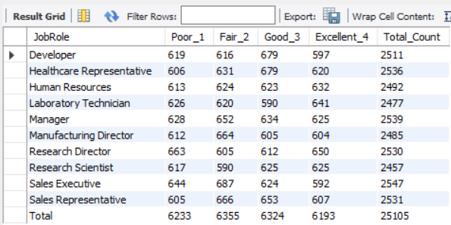
Insights from KPI 5:
From the analysis we can conclude the work life balance for the attrition employees as below,
For Research directors the work life balance is poor.
For the Sales representatives , Manufacturing Directors , managers and Sales executives the work life balance is fair.
For Research Scientists , Healthcare representatives und Developers the work life balance is good.
For Human resources , laboratory technicians the work life balance is excellent.

Slide 18
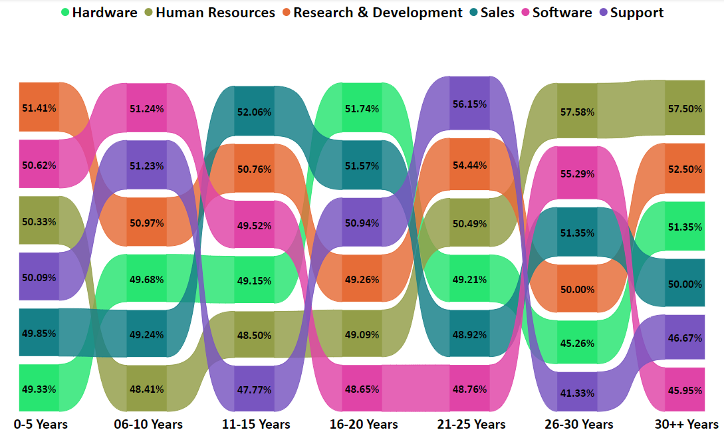
KPI 6 Attrition Rate Vs Years Since Last Promotion

Slide 19
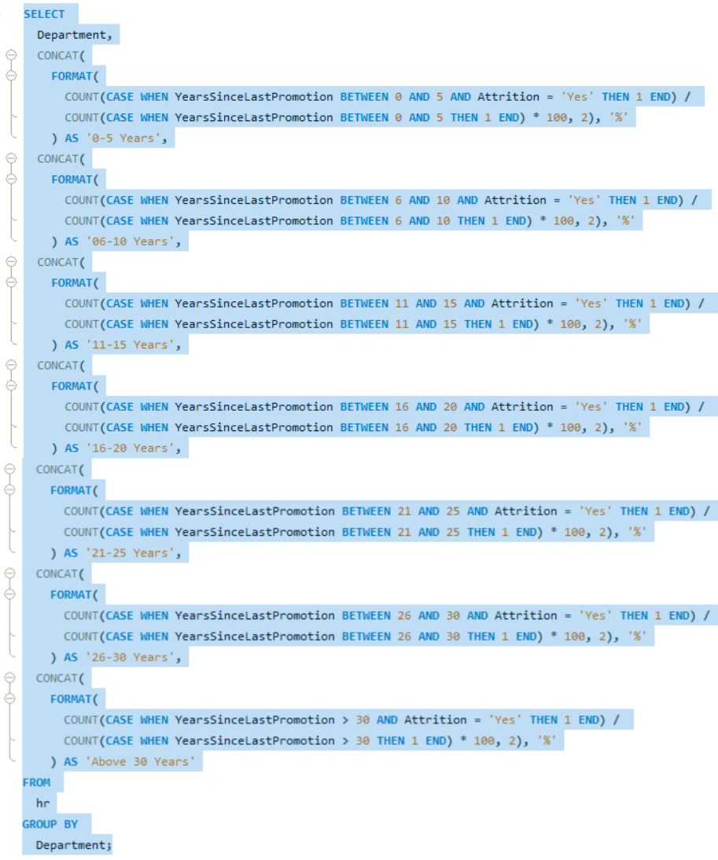
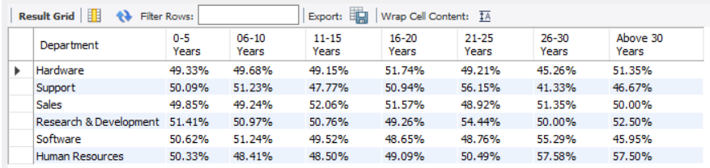

Slide 20

Insights from KPI 6:
From the analysis and Visualisation
For 0-5 years since Last year Promotion interval Research & Development and Hardware departments has highest and lowest attrition rate respectively.
For 6-10 years since last year promotion interval Human resources and software departments has highest and lowest attrition rate respectively.
For 11-15 years since last promotion interval support and sales departments has highest and lowest attrition rate respectively.
For 16-20 years since last promotion interval software & hardware departments has highest and lowest attrition respectively.
For 21-25 years since last promotion interval software and support departments has highest and lowest attrition respectively.
For 26-30 years since last promotion interval support and Human resources departments has highest and lowest attrition respectively.
For above 30 years since last promotion interval software and Human resources departments has highest and lowest attrition respectively.

Slide 21
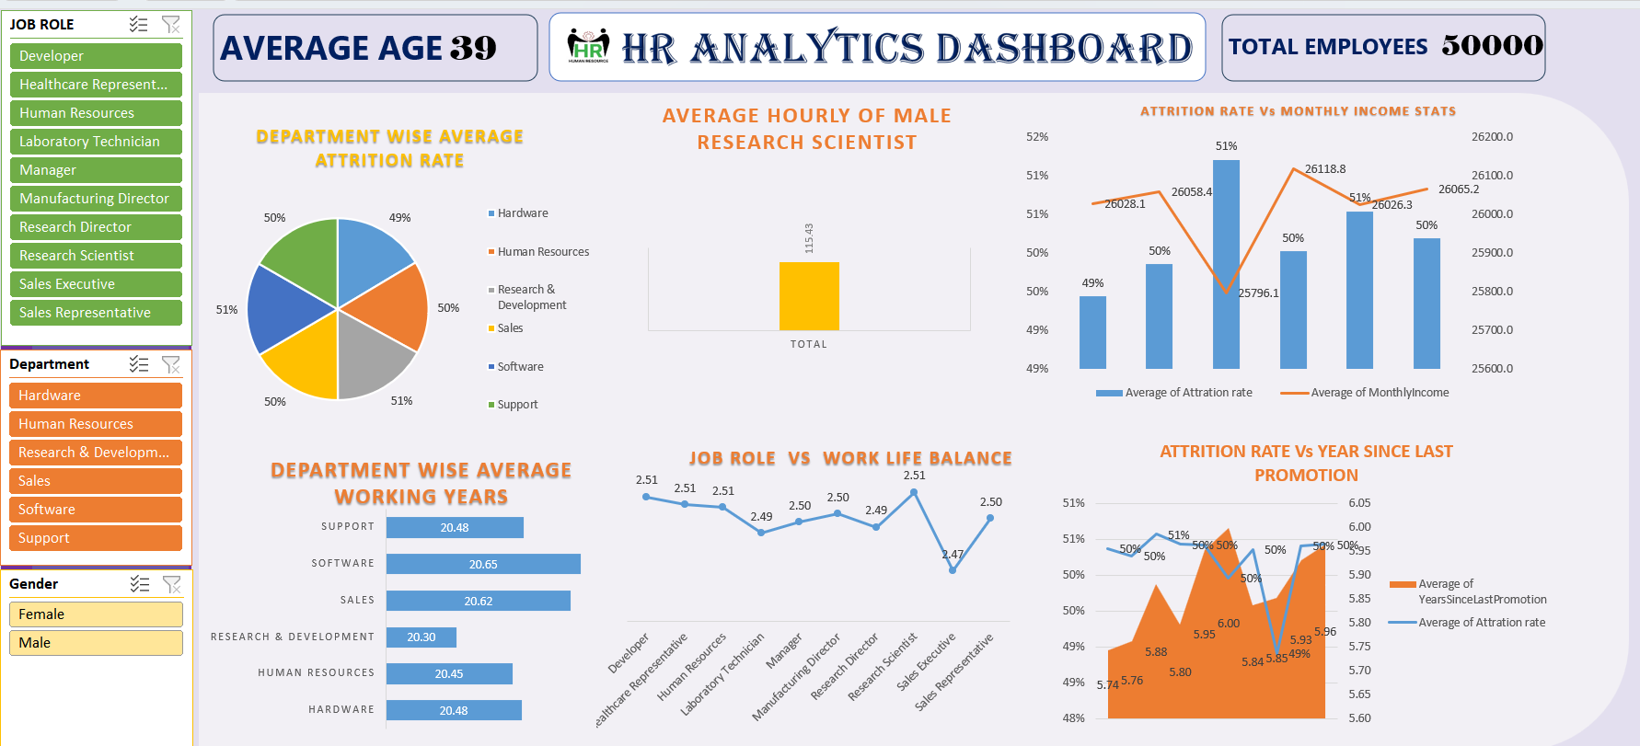
EXCEL DASHBOARD

Slide 22
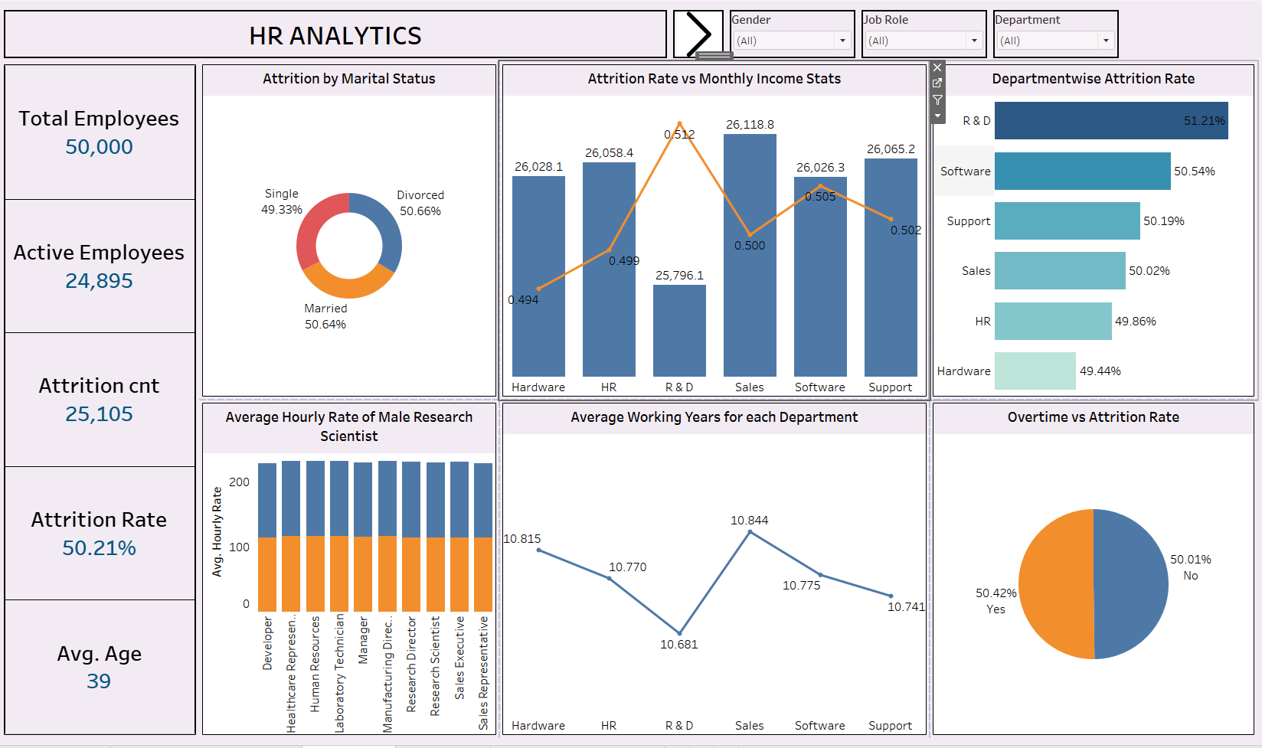
TABLEAU DASHBOARD

Slide 23
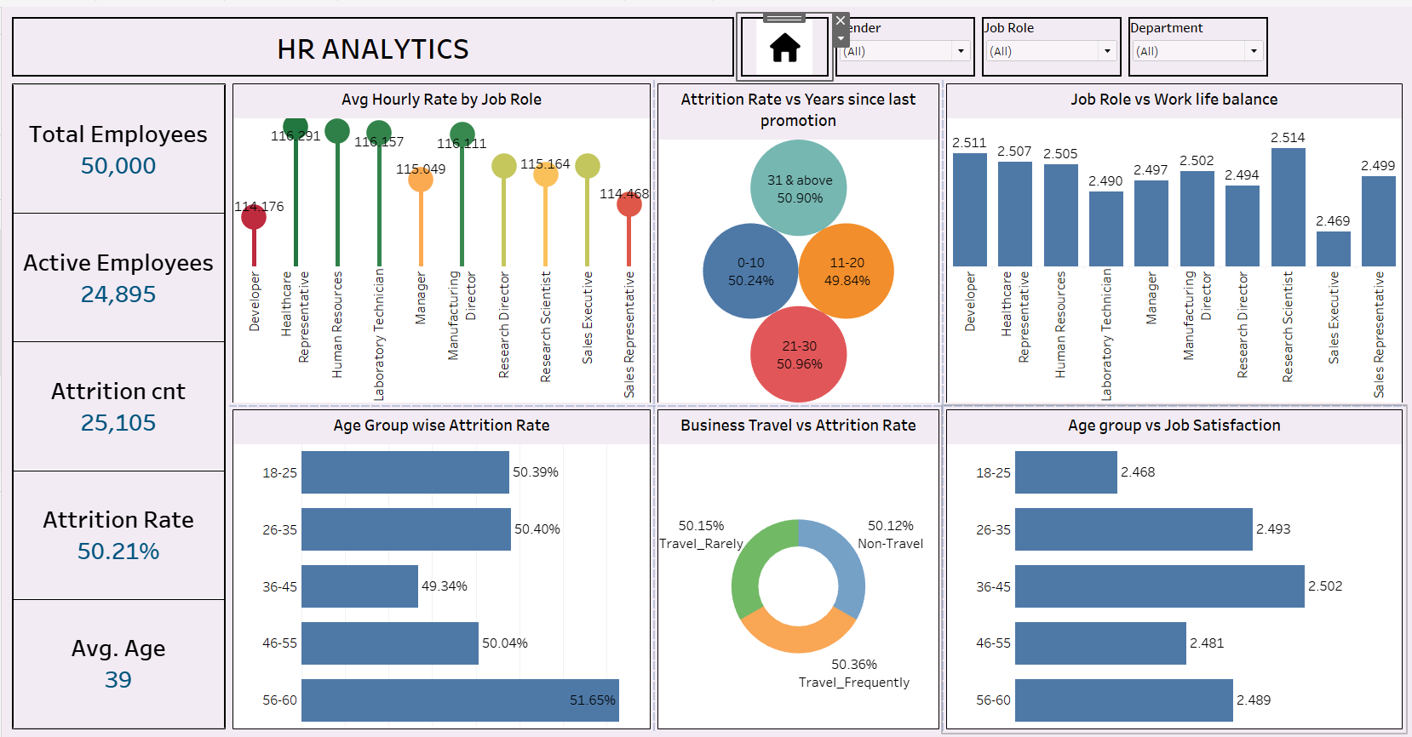
TABLEAU DASHOBARD

Slide 24
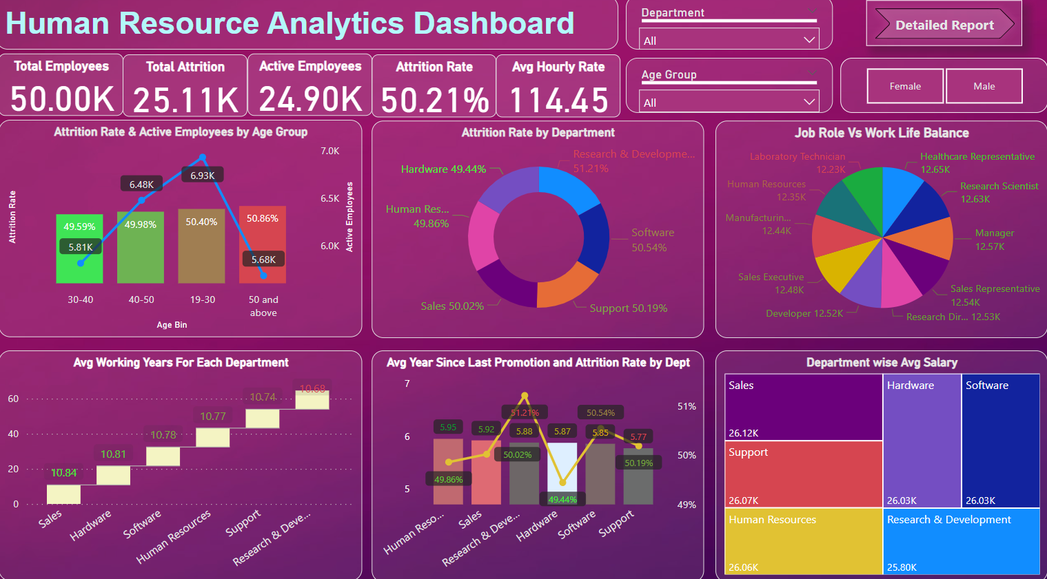
POWERBI DASHOBARD

Slide 25
Conclusion :
Conduct stay interviews: Instead of exit interviews, conduct stay interviews with employees to gather feedback about the job.
Improve employee engagement: Implement initiatives to improve employee engagement, such as regular feedback, recognition and rewards programs, and opportunities for career growth.
Address workload issues: Ensure employees have manageable workloads by regularly monitoring and adjusting workloads to prevent burnout and overwhelm.
Create a positive work environment: Foster a positive work environment by promoting a culture of respect, inclusivity, and teamwork. Encourage open communication and collaboration among employees.
Address pay and compensation issues: Ensure that employees receive fair pay and compensation for their work and to find out what motivates an employee to continue to work in an organization.

Slide 26

Thank you

